Slide 1
Logistic regression

Slide 2
Logistic regression
Logistic regression is useful when you are predicting a binary outcome from a set of continuous predictor variables.
The basic format of regression is
response variable ~ explanatory variables
The tilde should be read "is modeled by" or "is modeled as a function of."

Slide 3
Logistic regression
Logistic regression is a statistical method for analyzing a dataset in which there are one or more independent variables that determine an outcome.
The outcome is measured with a dichotomous variable (in which there are only two possible outcomes).
In logistic regression, the dependent variable is binary or dichotomous, i.e. it only contains data coded as 1 (TRUE, success, etc. ) or 0 (FALSE, failure, etc.).

Slide 4

Logistic regression
The goal of logistic regression is to find the best fitting model to describe the relationship between the dependent variable and a set of independent variables.
Logistic regression generates the coefficients (and its standard errors and significance levels) of a formula to predict a logit transformation of the probability of presence of the characteristic of interest:
where p is the probability of presence of the characteristic of interest.

Slide 5


Logistic regression
The logit transformation is defined as the logged odds:
and

Slide 6
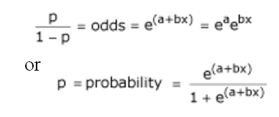
Logistic regression
The model logit(p) = a + bx is equivalent to the following:

Slide 7
Fitting the Logistic Regression Model
The function used to fit a logistic regression model to the data:
glm()
The glm() command is designed to perform generalized linear models(regressions) on binary outcome data, count data, probability data, proportion data and many other data types.
Notes:
We can use the function glm() to work with generalized linear models in R. It’s usage is similar to that of the function lm() which we previously used for multiple linear regression. The main difference is that we need to include an additional argument family to describe the error distribution and link function to be used in the model.

Slide 8
Fitting the Logistic Regression Model
To perform logistic regression in R, use the command: glm(response ~ explanatory_variables, family=binomial)
Note that the option family is set to binomial, which tells R to perform logistic regression.

Slide 9
Note:
Understand the problem statement given to you
What dataset it is, what attributes used, what type of attributes they are(either dependent/independent, response/explanatory etc).
Look into the file contents

Slide 10
Dataset: Motor Trend Car Road Tests
The data was extracted from the 1974 Motor Trend US magazine, and comprises fuel consumption and 10 aspects of automobile design and performance for 32 automobiles (1973–74 models).
A data frame with 32 observations on 11 variables.

Slide 11
Variables
[, 1] mpg Miles/(US) gallon
[, 2] cyl Number of cylinders
[, 3] disp Displacement (cu.in.)
[, 4] hp Gross horsepower
[, 5] drat Rear axle ratio
[, 6] wt Weight (1000 lbs)
[, 7] qsec 1/4 mile time
[, 8] vs V/S
[, 9] am Transmission (0 = automatic, 1 = manual)
[,10] gear Number of forward gears
[,11] carb Number of carburetors

Slide 12
Let’s Start with CARS Example
Let us work with the part of car datasets, considering
vs as the outcome variable,
mpg as a continuous predictor, and
am as a categorical (dichotomous) predictor.

Slide 13
Let’s Start with CARS Example
Import file
Create a subset of cars dataset
dat <- subset(motor_cars, select=c(X,mpg, am, vs))

Slide 14
Continuous predictor, binary outcome
In this example, mpg is the continuous predictor variable, and vs is the binary outcome variable.
logr_vm <- glm(vs ~ mpg, data=dat, family=binomial)
OR
logr_vm <- glm(vs ~ mpg, data=dat, family=binomial(link="logit"))

Slide 15
Continuous predictor, Binary outcome
To Print information about the model
logr_vm
To Print more information about the model
summary(logr_vm)
To Print coefficient of the model
exp(coef(logr_vm))
To Print confidence interval of the model
exp(confint(logr_vm))

Slide 16
Continuous predictor, Binary outcome
Plotting Graph
library(ggplot2)
ggplot(dat, aes(x=mpg, y=vs)) + geom_point() + stat_smooth(method="glm", method.args = list(family = "binomial"), se=FALSE)
plot(dat$mpg, dat$vs)
curve(predict(logr_vm, data.frame(mpg=x), type="response"), add=TRUE)

Slide 17
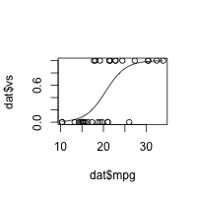
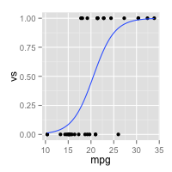
Continuous predictor, Binary outcome

